Slide 1




||JAI SRI GURUDEV||
ADICHUNCHANAGIRI INSTITUTE OF TECHNOLOGY
(Affiliated to Visvesvaraya Technological University, Belagavi , Approved by AICTE and Accredited by NAAC , New Delhi)
Chikkamagaluru , Karnataka, India-577102.
DEPARTMENT OF COMPUTER SCIENCE & ENGINEERING
Internship
“Full Stack Web Development”
on
“Empower Illiteracy”
Under the Guidance of :
Prof. Chethan P J., B.E., M.Tech., M.I.E.
Assistant Professor
Dept. of CS&E
Under the External Guidance of :
Mr. Rajashekar .,B.E
Managing Director,
E-Swara Technology
Presented by :
Srusti B N (4AI21CS102)
Harshitha S (4AI21CS035) Sangeetha D R (4AI21CS081)

Slide 2
AGENDA
Introduction
Motivation
Problem Statement
Objectives
System Requirement Specification
Code with Explanation
Snapshots
Conclusion

Slide 3
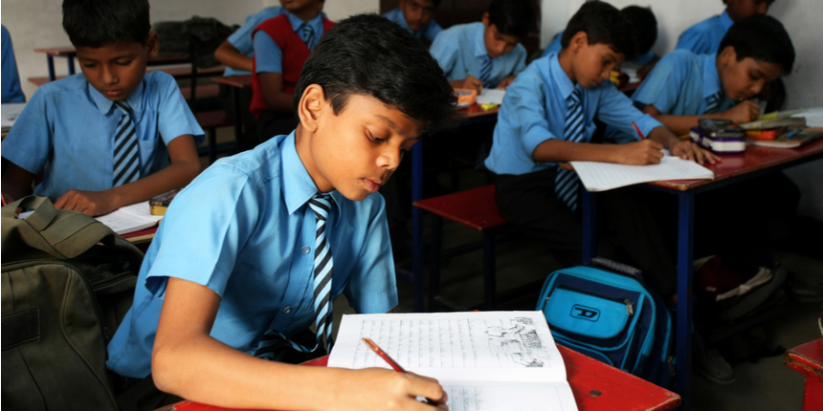
Introduction
Illiteracy is the inability to read and write
There are many illiterates who have good skill in carpentry,farming,driving..etc but unable to find work.
As illiterate people are unaware of internet they are instructed to go nearby helping centers like(meeseva,make in india,digital india or any) for registering.
Our idea is to provide a framework for medium connecting people who are looking for educations.
we can provide a platform for educations with the help of Android App or Web App.

Slide 4
Motivation
Education is the most powerful weapon which you can use to change the world .
The motivation to empower illiteracy lies in the recognition that education is the cornerstone of individual empowerment and collective advancement.
The empower illiteracy is grounded in the belief that educated individuals are better equipped to address the challenges facing our world.
Finally, the motivation to empower illiteracy is grounded in the belief that educated individuals are better equipped to address the challenges facing our world.

Slide 5
Problem Statement
There are so many students are there they don`t have even basic education due to some financial issues
or other problems
If the students are register to our website we investigate about there background and then provide the
basic education

Slide 6
Objectives
The objective for addressing illiteracy is to empower individuals with essential literacy skills, fostering
personal development, economic opportunities, and overall community advancement.
Efforts to combat illiteracy aim to break the cycle of ignorance and lack of access to education.
By promoting literacy, we enhance people's ability to communicate, think critically, and participate
actively in society.
Furthermore, tackling illiteracy is essential for promoting lifelong learning, enabling individuals to
adapt to evolving technologies and knowledge.

Slide 7
System Requirement Specification
Visual Studio Code | It is a source code editor developed by Microsoft for Windows, Linux and macOS.
XMAPP | It is a free open –source cross –platform webserver solution stack package developed by APACHI friends.
MySQL | User to store, manage and retrieve structured data
APACHI | Allows users to publish web site on internet
Bootstrap | It is a free front-end framework for faster and easier web development.
Browser | To run the code written and get the output

Slide 8
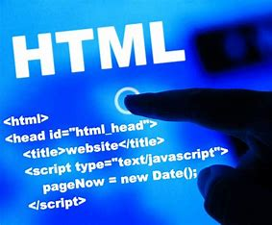
HTML
What is HTML?
HTML stands for Hyper Text Markup Language.
HTML is the standard markup language for creating Web pages.
HTML describes the structure of a Web page
HTML consists of a series of elements.
HTML elements tell the browser how to display the content.
HTML elements label pieces of content such as "this is
heading", "this is a paragraph", "this is a link", etc.

Slide 9
CSS
CSS means Cascading Style Sheets.
It styles how HTML content looks on a webpage.
Controls colors, fonts, and layout design.
Keeps design separate from the webpage's structure.

Slide 10
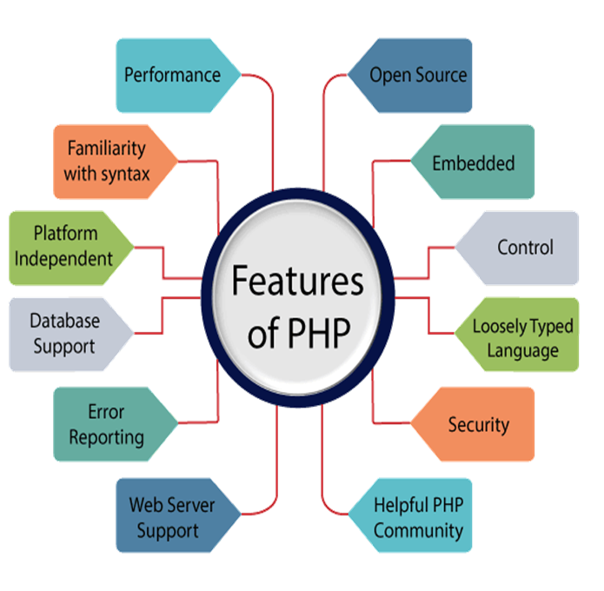
PHP
PHP stands for Hypertext Preprocessor.
PHP is a widely-used, open source scripting language.
PHP scripts are executed on the server.
It runs on the browser and is also capable of running in the
command line.
PHP is written in the high-level C programming language.
<?
?>

Slide 11
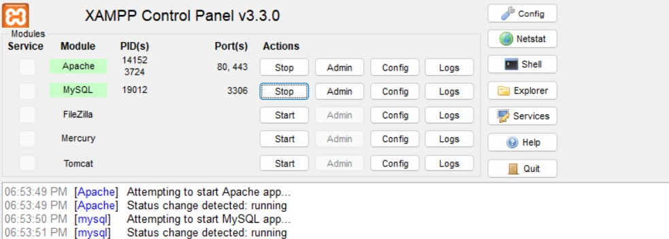
XAMPP
XAMPP stands for X-operating system, Apache, Mysql, Php, Perl.
XAMPP is a free and open-source cross-platform web server solution stack package developed by Apache Friends.
The goal of XAMPP is to build an easy way to install distribution for developers to get into the world of Apache.

Slide 12
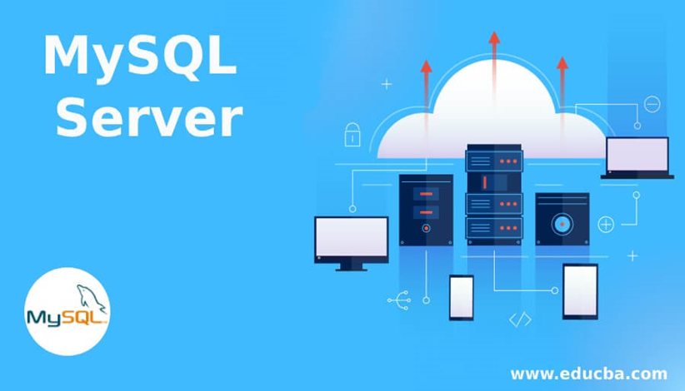
MY SQL
Michael Widenius is known as the Father of MySQL.
MySQL is a database management system.MySQL is a relational database that uses structured query language .
To add, access, and process data stored in a computer
database, you need a database management system
such as MySQL Server.

Slide 13
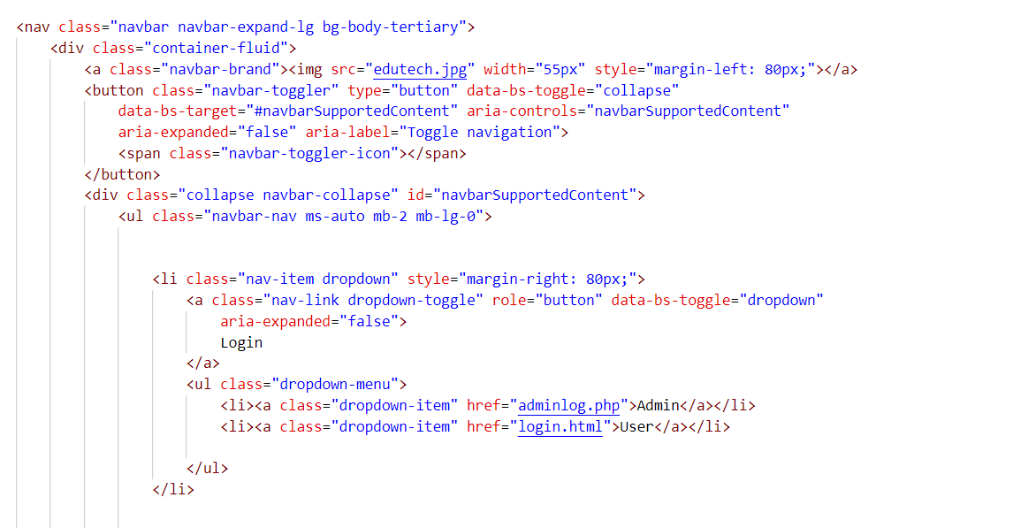
Front Page Code:-
(HTML)

Slide 14
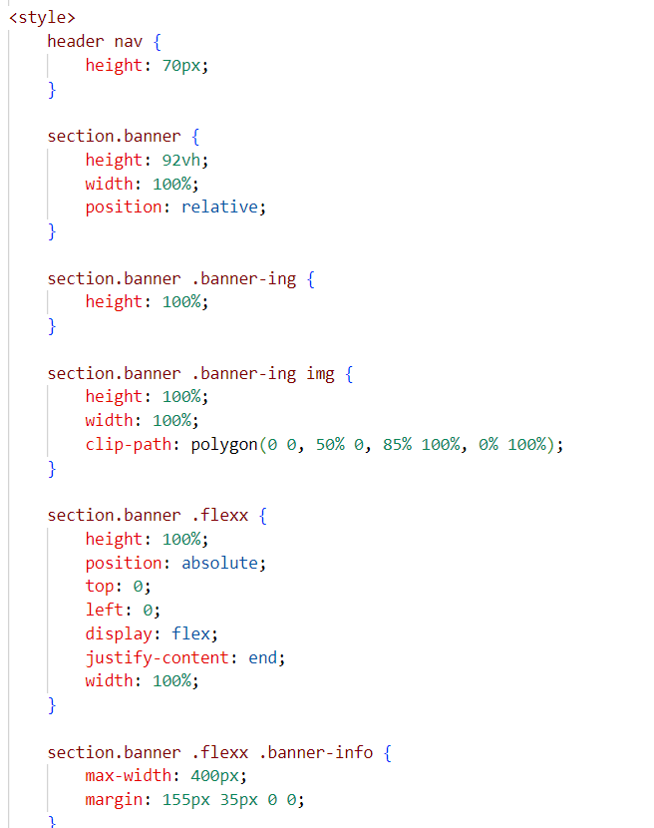
CSS Code

Slide 15

Front Page:-

Slide 16
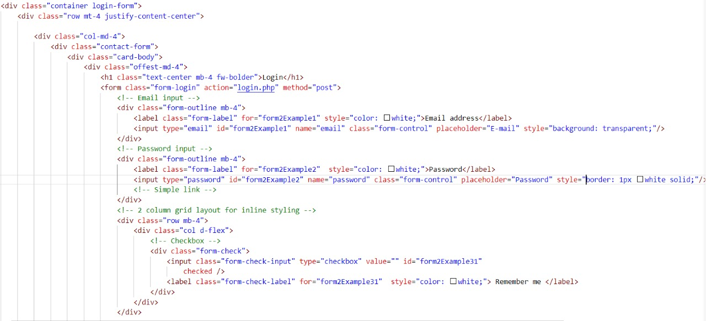
Login Code:- (HTML)

Slide 17
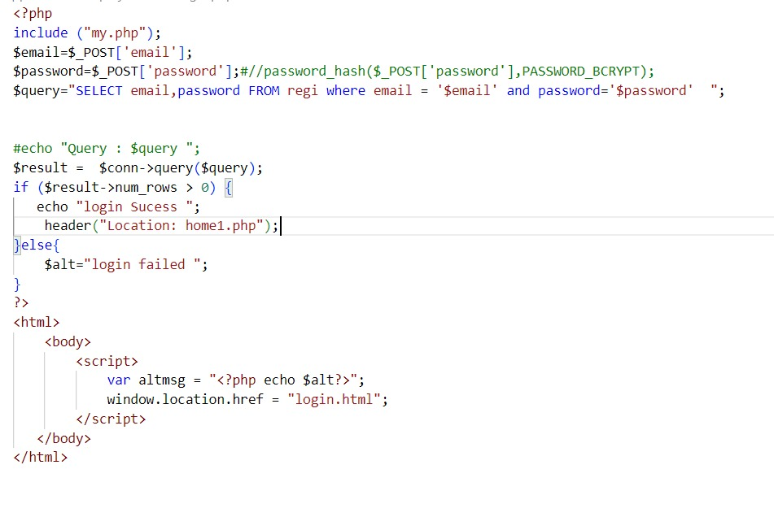
PHP Code:-

Slide 18
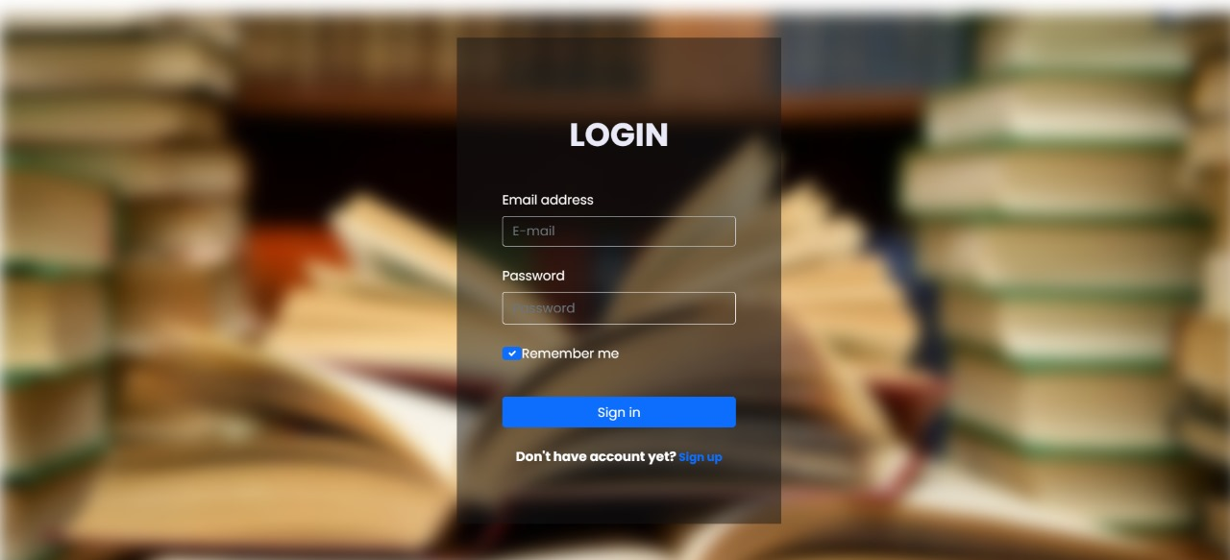
Login Page:-

Slide 19
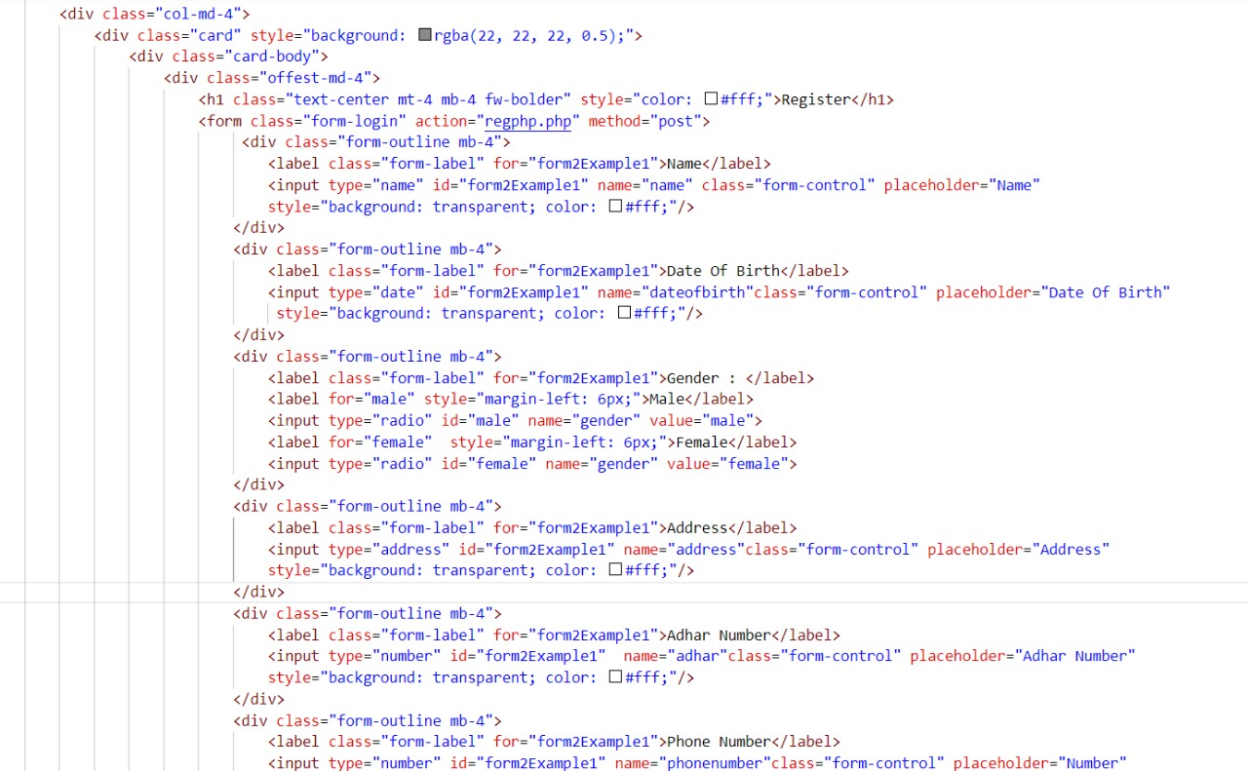
Register code:- (HTML)

Slide 20
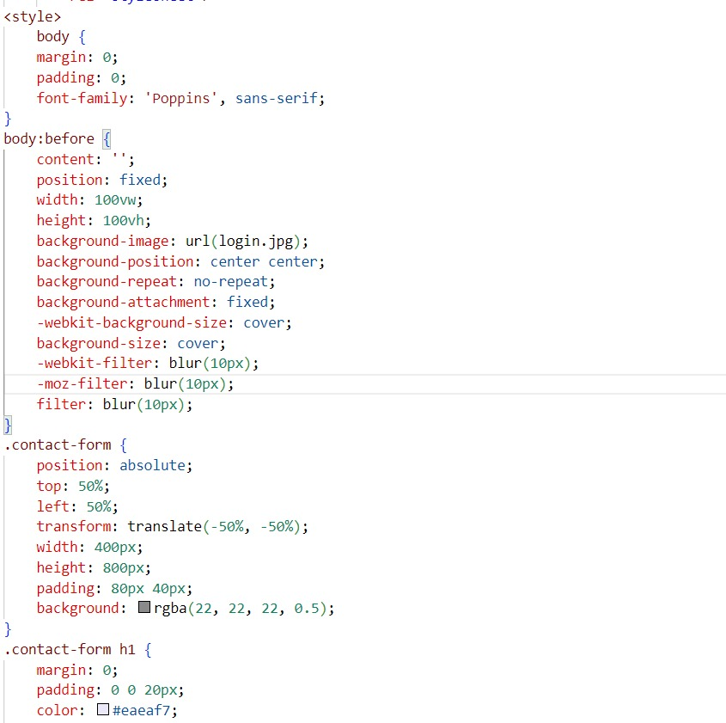
CSS Code

Slide 21
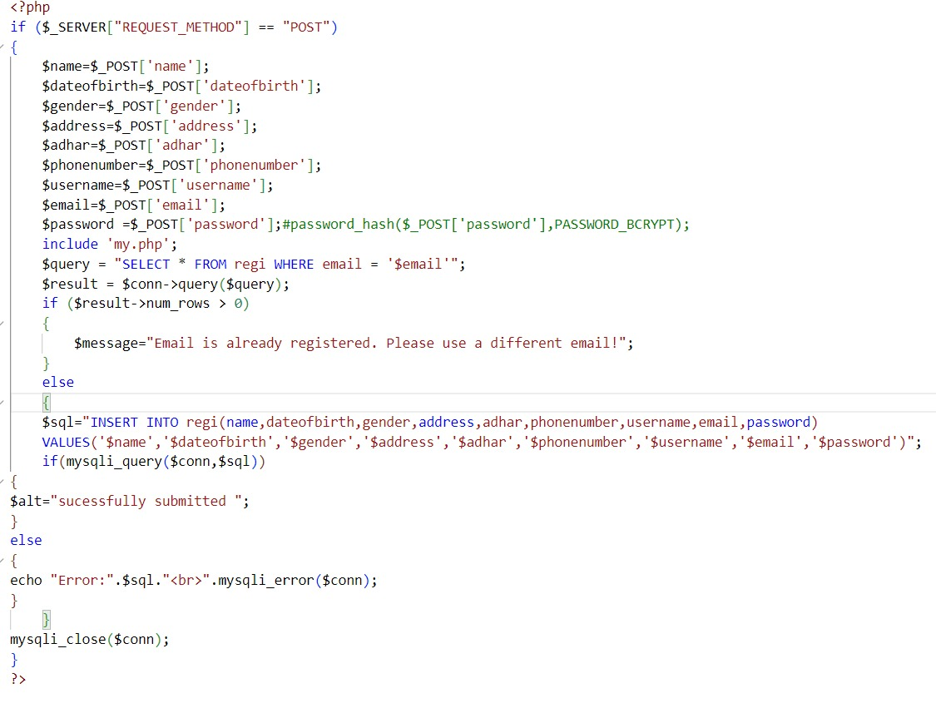
PHP Code

Slide 22
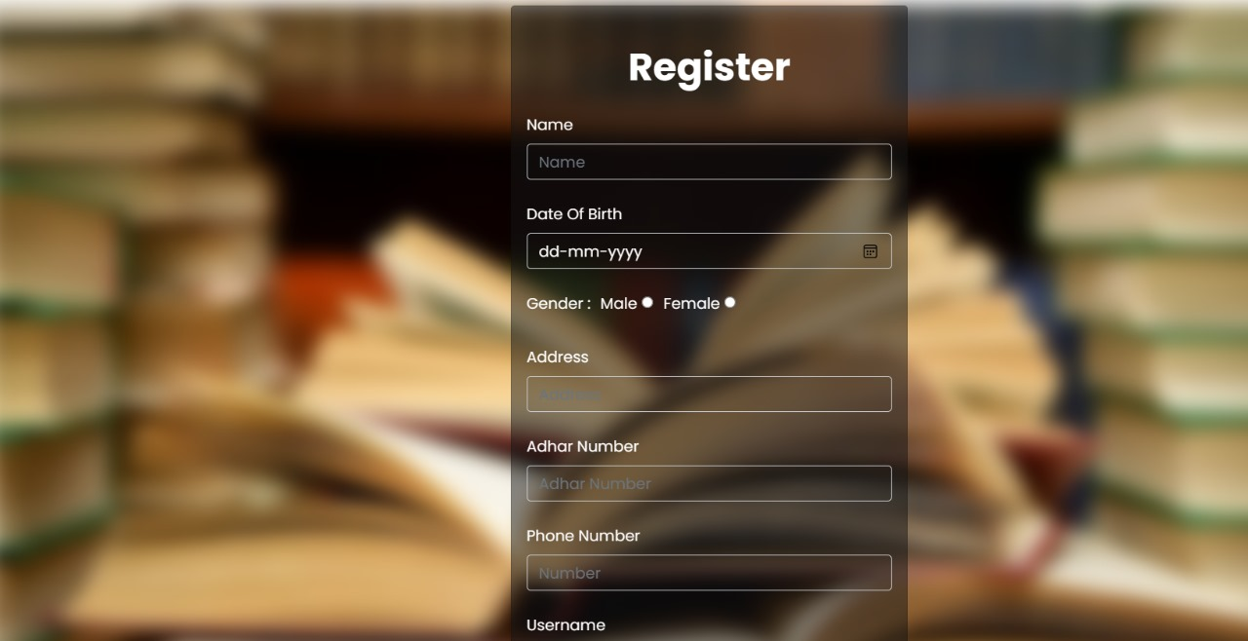
Register Page:-

Slide 23
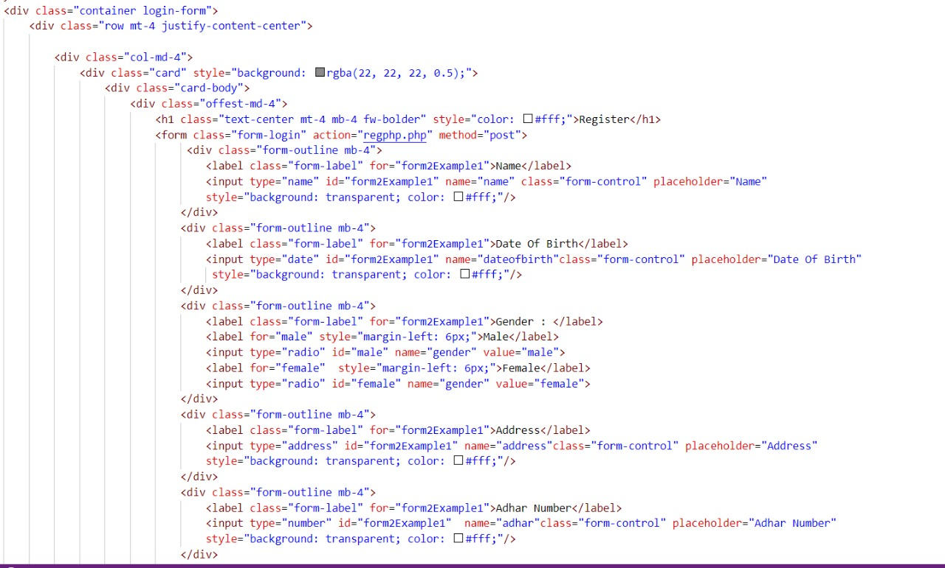
Home Page Code:- (HTML)

Slide 24
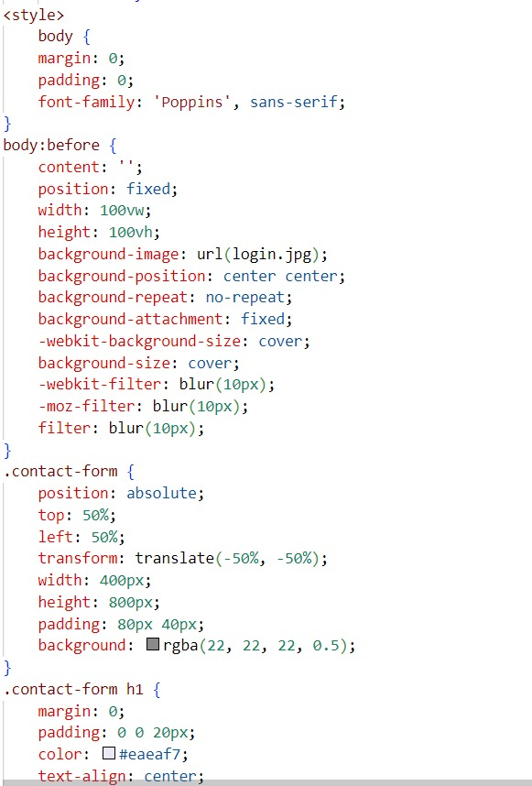
CSS Code

Slide 25
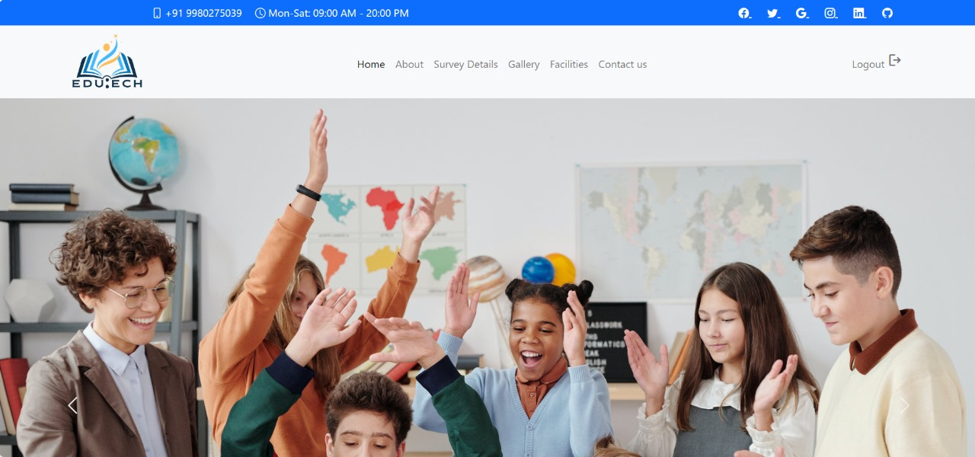
Home Page:-

Slide 26
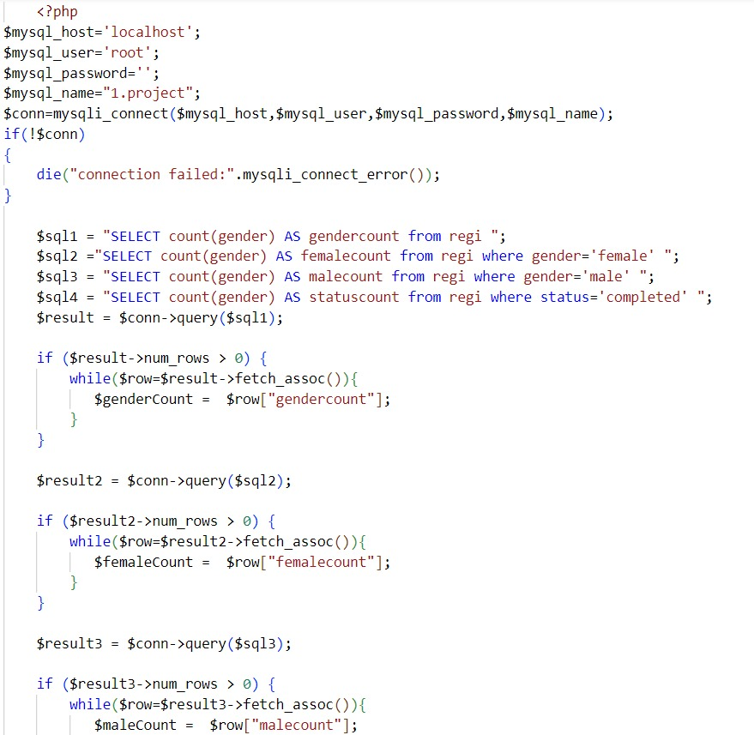
Survey Details Code:- (PHP)

Slide 27
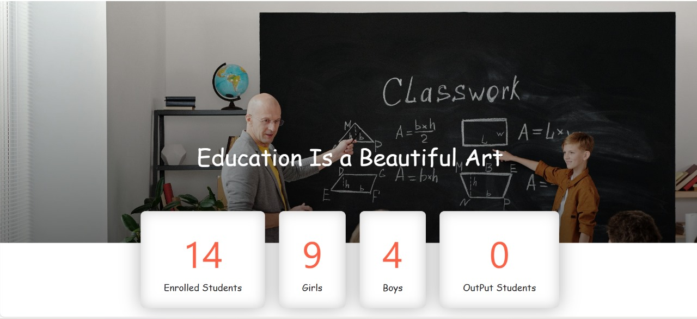
Survey Details Page:-

Slide 28
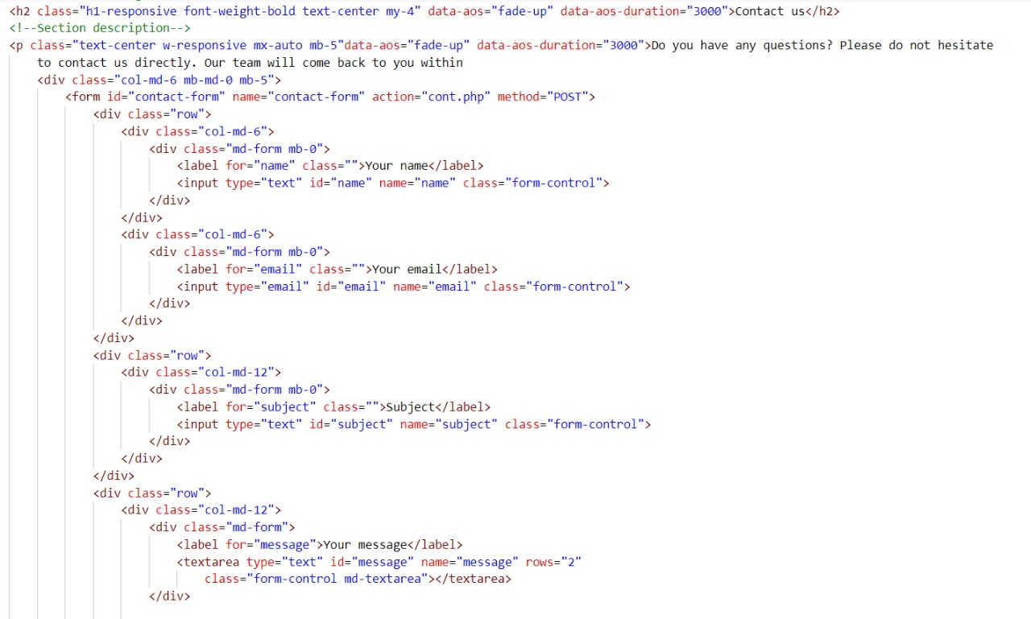
Contact Us Code:- (HTML)

Slide 29
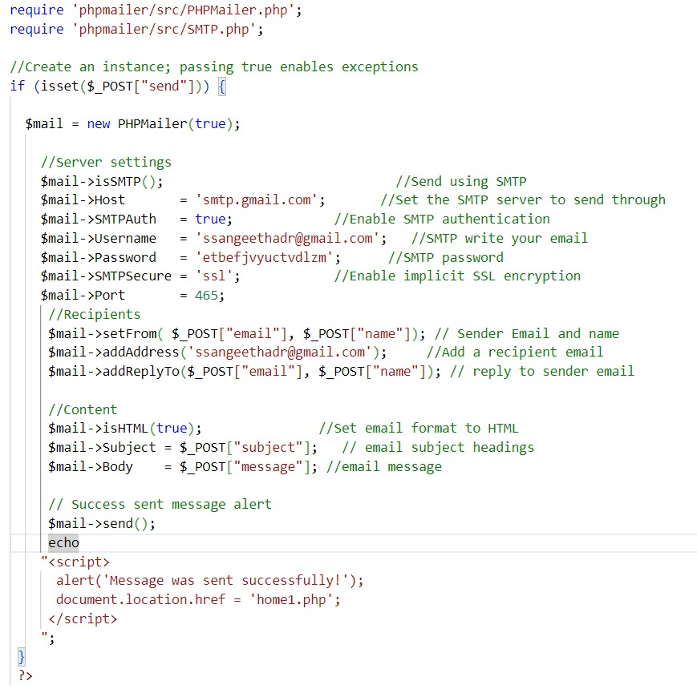
PHP Code

Slide 30
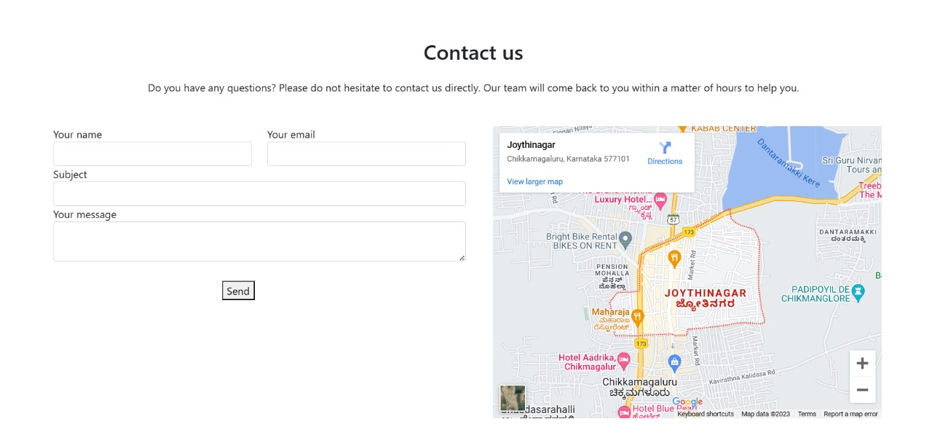
Contact Us Page:-

Slide 31
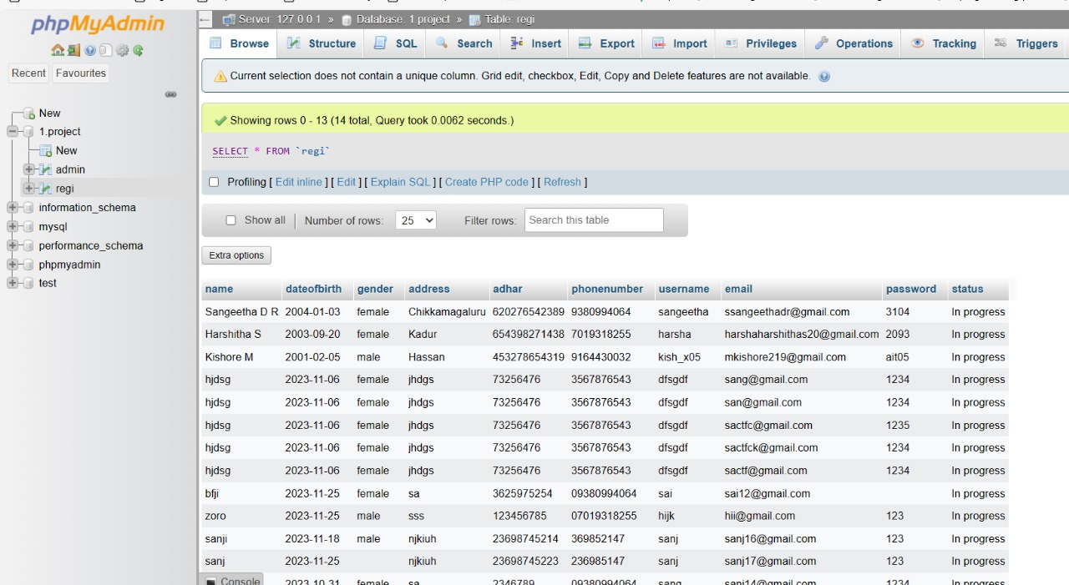
Database:-

Slide 32
Conclusion:-
In conclusion, empowering literacy is not just a noble endeavor; it is a transformative force that breaks
chains of ignorance, opens doors to opportunities, and fosters a more informed and engaged society.
By investing in literacy initiatives, we not only enhance individual lives but also contribute to the
collective growth and development of communities, fostering a brighter and more
equitable future for all.
Empowering literacy is a gateway to knowledge, enabling individuals to navigate an increasingly
complex world with confidence.

Slide 33
THANK YOU

